Slide 1
News Media Web Application
TASK 3

Slide 2

News Media Web Application
The News media web applications can provide information about current events and topics such as politics, sports, health, and entertainment. News sites can be affiliated with newspapers, magazines, television networks, businesses, or other entities.
LMS USERNAME
NAME
BATCH
au420420104042
SANMATHI S
CA1
au420420104040
SAKTHI UMA S
CA1
au420420104007
CHARUMATHI B
CA1

Slide 3
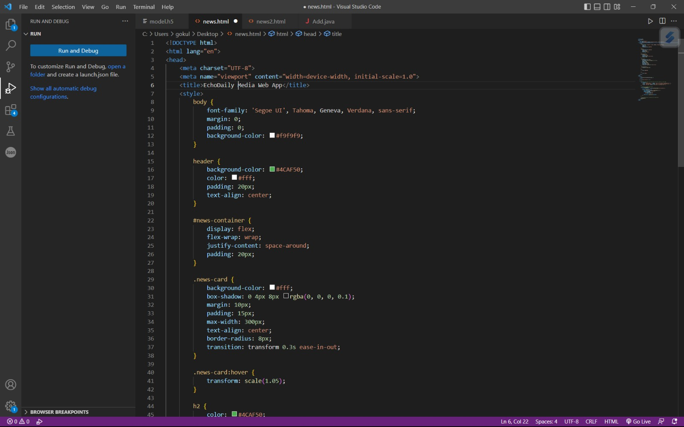

Slide 4
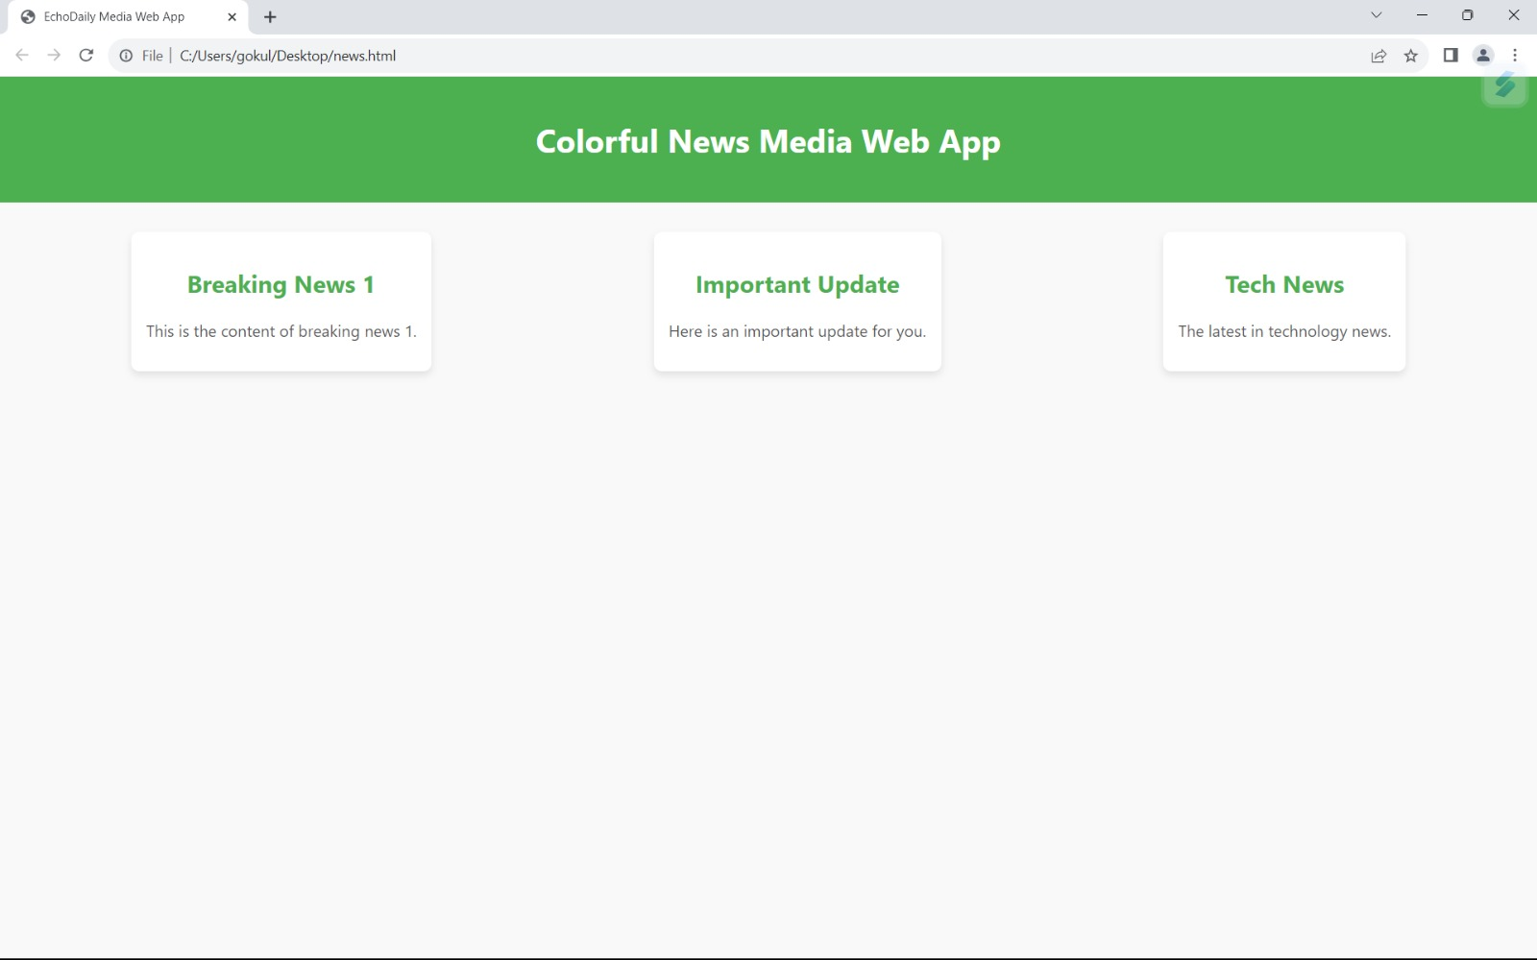

Slide 5


https://github.com/Sanmathi12345/NM-APEC-CSE-GROUP-S

Slide 6


